Slide 1
Smart Ventilator
Sankalp KHANNA (20371974)
Wang foon lee (20420191)

Slide 2
Index
Aim
Flow Chart
Circuit Diagram
Components
HC-SR04
PWM

Slide 3
Aim
To create a comfortable and energy efficient workspace:
Turning the fan on and off by detection
Control the speed of the fan according to the distance

Slide 4
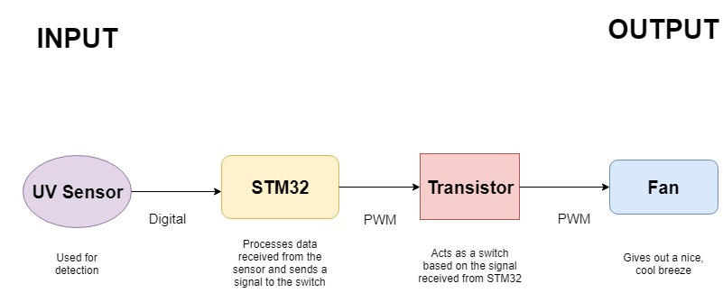
Flow Chart

Slide 5
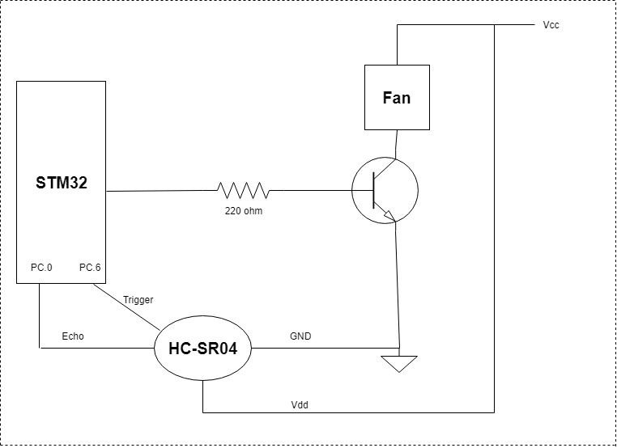
Circuit Diagram

Slide 6
Components
HC-SR04: UV sensor, detects human presence
STM32: Used for processing signals from sensors and provide a signal to the output
TIP41C: It is switched as a switch, the base is connected to STM32
Fan: Provides the user with a fresh, cooling breeze

Slide 7
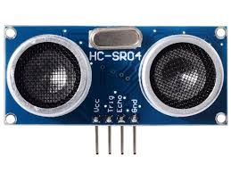
HC-SR04
A uv sensor, used to detect human presence

Slide 8
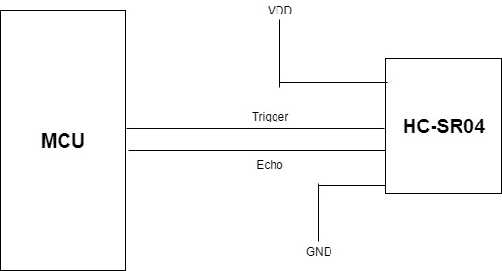
Typical connection

Slide 9
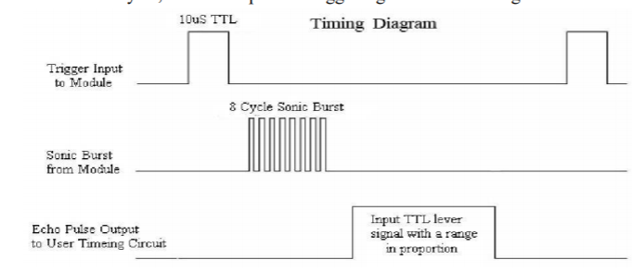
Data transmission and receiving

Slide 10
PWM
Used in Master slave mode
TIM3 acts as master
TIM4 acts as slave
Depending on distance, pulse of TIM4 changes
Output of TIM4 drives the base of transistor
TIM3
Period=900KHz
Pulse=72
TIM4
Period=3KHz
Pulse=600
Transistor base

Slide 11
Demonstration

